Slide 1
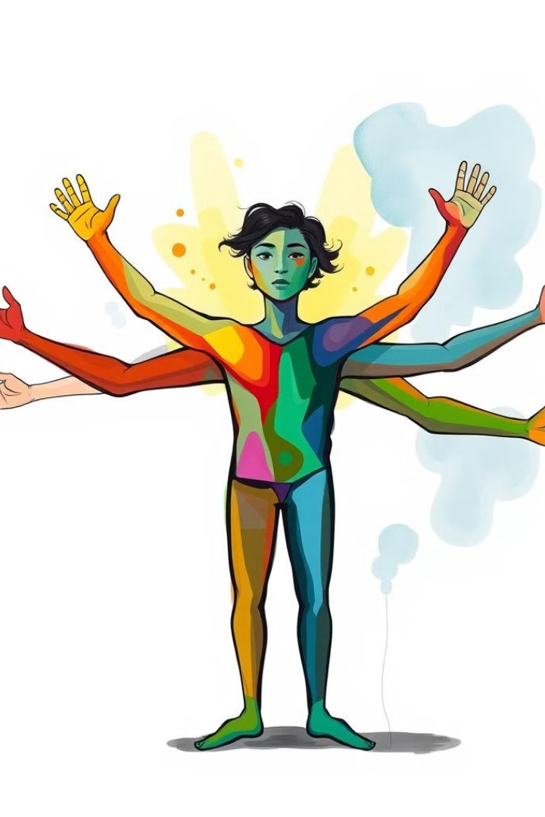
Other Aspects of Personality
Body Language
Problem Solving and Decision-Making Skills
Conflict, Stress, and Time Management
Leadership and Teamwork
Work Ethic: Good Manners and Etiquettes

Slide 2
Body Language
Non-Verbal Communication
Impact on Perception
Gestures, facial expressions, posture, and eye contact convey emotions, attitudes, and intentions.
Body language influences how others perceive you, impacting relationships and opportunities.

Slide 3

Problem Solving and Decision-Making Skills
1
Problem Solving
Identifying, analyzing, and resolving issues effectively.
2
Decision-Making
Choosing the best course of action from available options.

Slide 4
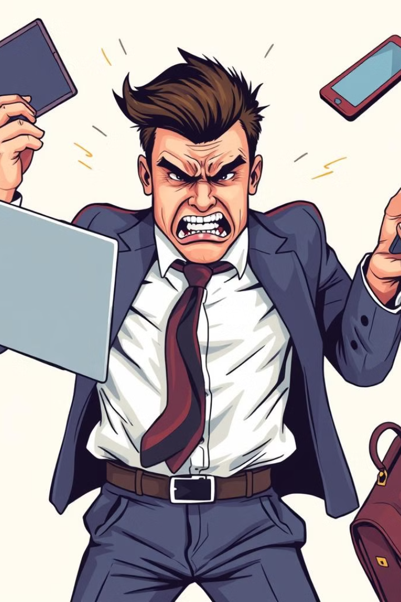
Conflict, Stress, and Time Management
Conflict Management
Stress Management
Resolving disagreements constructively through active listening, finding common ground, and collaborating for win-win solutions.
Techniques to cope with pressure, including prioritizing tasks, practicing mindfulness, and maintaining work-life balance.
Time Management
Organizing and planning how to divide time between activities, setting priorities, using tools, and avoiding procrastination.

Slide 5
Leadership and Teamwork
Leadership
Teamwork
Inspiring and guiding others towards a common goal, demonstrating confidence, empathy, and effective communication.
Collaborating with others to achieve shared objectives, fostering cooperation, respect, and active participation.

Slide 6



Work Ethic: Good Manners and Etiquettes
Work Ethic
Good Manners and Etiquettes
Demonstrating professionalism, dedication, and responsibility in the workplace.
Politeness, respect, and consideration for others, including saying "please" and "thank you," punctuality, and dressing appropriately.

